Slide 1
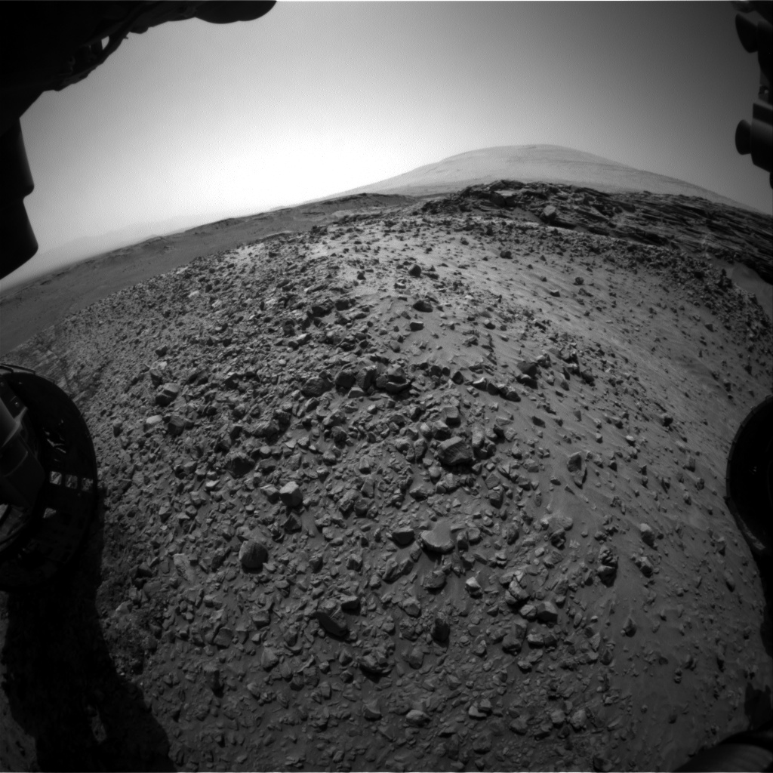
Lowder Legends
Project Overview:
Preface: Our team had virtually 0 experience with coding. However, through utilizing web searches, online developer forums and various free platforms, we were able to create an end-to-end product to accomplish our goal.
Step 1 – Back-End Integration: We brainstormed about how to integrate the NASA API in a scripting language. Collectively, we decided that python was the simplest, yet most dynamic platform for out attempt at implementation. We wrote a script that accesses the API and queries the image database according to user inputs & specifications
Step 2 – Front-End: Using “Squarespace” platform we constructed and designed a website that acts as a user-friendly interface that is capable of displaying an output of query results.
Step 3 User Form: Using “query builder” we built a query for users to populate. The query sends the input to a file in which our Python script can access.
Step 4 Calling the Images: The results of the respective query are given, translated, and the appropriate images are displayed on the screen.
Conclusion: While we didn’t anticipate being able to make much progress, we were able to design every layer of the product needed to make it function. With additional time and proper implementation, we believe our product would be exceptionally functional and efficient.

